Slide 1
R Basics
Data Types, Variables

Slide 2
R studio – basic
Variables
Data Types – Vectors , Lists, Matrices, Array, Factors, Data Frame
Vectors -> Logical, Numeric, Integer, Complex, Character, Raw.

Slide 3
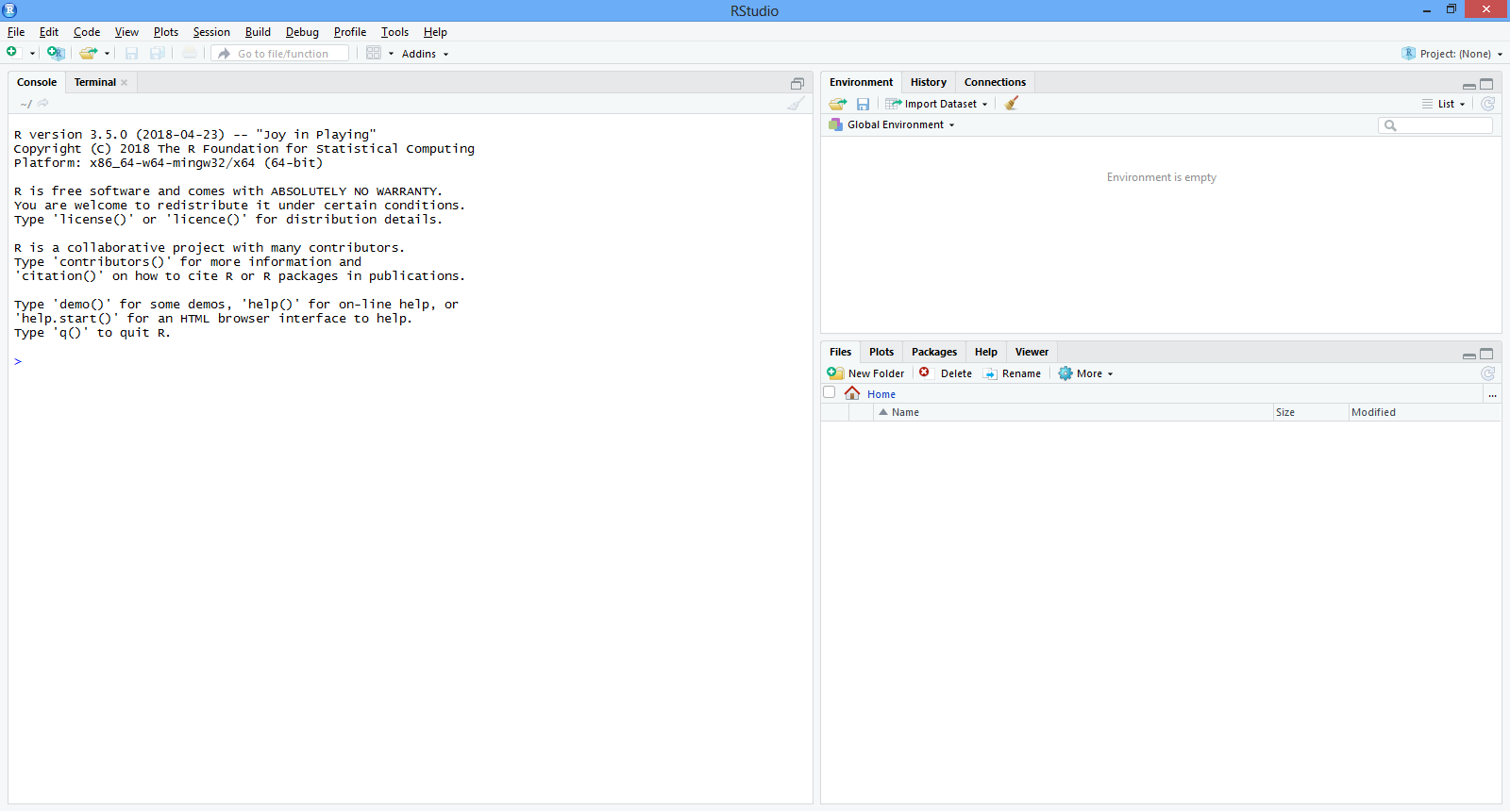
R studio Console/IDE

Slide 4
Variables
Do not confuse with Stats – variable
A variable provides us with named storage that our programs can manipulate.
valid variable name consists of letters, numbers and the dot or underline characters. The variable name starts with a letter or the dot not followed by a number.

Slide 5
var_name2. = Valid
var_name% = Invalid
2var_name = invalid
.2var_name = invalid
_var_name = invalid

Slide 6
> var_name% <- c(10,20)
Error: unexpected input in "var_name% <- c(10,20)"
> var_name <- c(10,20)
> 2varname <- c(10.20)
Error: unexpected symbol in "2varname“
> .2varname <- c(10.20)
Error: unexpected symbol in ".2varname"
> _2varname <- c(10,20)
Error: unexpected input in "_"

Slide 7
Maths
X <- c(10,5,6,7,3)
X Object Variable
C = concatenate, Join
This is Vector
This is Numerical vector
1/x
Y <- c(x,0,x)

Slide 8
Vector Arithmetic
V <- (2*x)+y+1
x <- c(10,5,6,7,3)
> x [1] 10 5 6 7 3
> 1/x
[1] 0.1000000 0.2000000 0.1666667 0.1428571 0.3333333
> y <- 5
> v <- (2*x)+y+1
> v [1] 26 16 18 20 12
Explain this to students
<- is assigment

Slide 9
Common Functions
Length()
Min()
Max()
Log(x)
Exp()
Mean()
Sum()

Slide 10
Formulae sample
Variable = sum( (x-mean(x))^2) / ( Length(x)-1

Slide 11
Generate Random Sequence
[1:30]
Seq(2,10)
Seq(2,10 by=2)
Rep(x, time=5)

Slide 12
Logical vector
Need separate explanation
Temp <- x > 13
< <=, > , >=
== , != , &, |

Slide 13
Character Vector
Txt <- c(“hyd”,”Bang”,”Che”)
Paste()
Paste( c(“x”,”y”), 1:10, sep=“”)
z <- paste( c("x","y"), 1:10, sep="")
Txt[1] # index
Txt[2]
Explain – Global Env, History in R studio

Slide 14
Data Types
Vectors
Lists
Matrices
Arrays
Factors
Data Frames

Slide 15
Vector
The simplest of these objects is the vector object and there are six data types of these atomic vectors, also termed as six classes of vectors. The other R-Objects are built upon the atomic vectors.
six classes of vectors
Logical , Numeric, Integer, Complex, Character, Raw
print(class(x)) : this give which type it is

Slide 16
> #vector
> states <- c("TS","AP","TN")
> states
[1] "TS" "AP" "TN"
> print(class(states))
[1] "character"
>

Slide 17
LIST
A list is an R-object which can contain many different types of elements inside it like vectors, functions and even another list inside it.
> list1 <- list(c("TS","AP","TN"),log(15),sin(45))
> list1
print(class(list1))

Slide 18
matrix
> # matrix
> M <- matrix(c(1,1,1,2,2,2,3,3,3),nrow=3,ncol=3)
> M
A matrix is a two-dimensional rectangular data set. It can be created using a vector input to the matrix function.
> M <- matrix(c(1,1,1,2,2,2,3,3,3),nrow=3,ncol=3,byrow = TRUE)

Slide 19
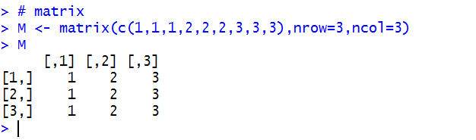
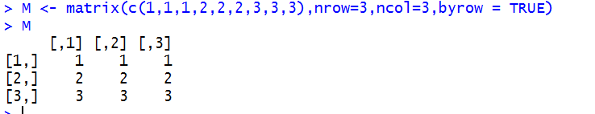
Matrix – 2D

Slide 20
Arrays
Arrays
While matrices are confined to two dimensions, arrays can be of any number of dimensions.
> ar <- array(c("Green","blue"))
> ar
[1] "Green" "blue"
> print(ar)
[1] "Green" "blue"
> print(class(ar))
[1] "array"

Slide 21
Array with dim
> ar <- array(c("Green","blue"),dim=c(2,3))
> ar

Slide 22
Factors
Factors are the r-objects which are created using a vector.
It stores the vector along with the distinct values of the elements in the vector as labels.
The labels are always character irrespective of whether it is numeric or character or Boolean etc. in the input vector. They are useful in statistical modeling.

Slide 23
Factors
> states_in_india = array(c("TN","AP","TS","KT","TS","AP"))
> fa_india = factor(states_in_india)
> fa_india
[1] TN AP TS KT TS AP
Levels: AP KT TN TS
>

Slide 24
Factor
> nlevels(states_in_india)
[1] 0
> nlevels(fa_india)
[1] 4
>

Slide 25
Data Frames
Data frames are tabular data objects.
Each column separate data type
https://stackoverflow.com/questions/18803354/ending-prompt-in-r ( common problem) – Use Escape

Slide 26
Data.frame
> BMI <- data.frame (
+ gender = c("female","male","male"),
+ height = c(157,171,162),
+ age = c(42,28,26)
+ )
> BMI
Note use of “+” and “,”

Slide 27
Summary
Vector = c()
Lists = List()
Matrices = matrix()
Array = array()
Factors = Factor()
Data Frame= data.frame()

